Slide 1
Kubernetes
Scope, Objective, Target Audience, Schedule
SoftUni Team
Technical Trainers
Software University
https://about.softuni.bg

Slide 2
Table of Contents
Communication
Course objectives, scope, and schedule
Infrastructure and materials
Exams and evaluation criteria
About Me
2
Notes:
2

Slide 3










SoftUni Diamond Partners

Slide 4



Educational Partners

Slide 5

Communication

Slide 6
Have a Question?
sli.do
#Kubernetes
https://www.facebook.com/groups
/KubernetesOctober2021
Notes:
6

Slide 7

Course Objectives, Scope, and Schedule

Slide 8
Course Objectives
Feeling comfortable working with Kubernetes
Working with basic objects
Deploying simple applications
Small cluster creation and management
Monitoring and troubleshooting applications
Monitoring and troubleshooting clusters

Slide 9
Course Scope and Schedule (1)
Week #1
Introduction to Kubernetes
Kubernetes Architecture, API, and Tools
Working with Basic Objects
Week #2
Basic Cluster Installation
Manage and Upgrade Kubernetes Cluster
Highly-available Kubernetes Clusters

Slide 10
Course Scope and Schedule (2)
Week #3
Resource Requirements, Limits, and Quotas
Network Policies
Authentication, Authorization, and Admission Control
Week #4
Volumes and Volume Claims
Stateful Sets
Configuration Maps and Secrets

Slide 11
Course Scope and Schedule (3)
Week #5
Multi-container Pods
Autoscaling and Scheduling
Daemon Sets, Jobs and Cron Jobs
Ingress Resources and Controllers
Week #6
Health and Status Checks
Logging and Troubleshooting

Slide 12
Course Scope and Schedule (4)
Week #7
Templating Tools
Getting Started with Helm
Creating Simple Charts
Week #8
Course Overview
Exam Preparation

Slide 13

Course Timing and Duration
Lectures: ~ 11 hours
Practical exercises: ~ 11 hours
Homework: yes
Schedule: October 2021 – December 2021
Every Thursday between 18:30 and 21:30
Regular Exam: 8 January 2022
Retake Exam: 15 January 2022
18:30 – 19:30 Part 1
19:30 – 19:40 Break 1
19:40 – 20:30 Part 2
20:30 – 20:40 Break 2
20:40 – 21:30 Part 3

Slide 14

Infrastructure and Materials

Slide 15
Required Resources
64-bit CPU with VT-x/AMD-V
Free memory 8 GB or more
Free disk space 100 GB or more
Virtualization solution (Hyper-V, VirtualBox, VMware Workstation, …)
You may use any cloud platform (Azure, AWS, GCP, …) as well
Additional tools like Minikube, Vagrant, etc.

Slide 16

Why English?
Why the slides are in English?
English is the native language of the IT people
Specific terminology should be in English
Translations are inaccurate and funny
Just learn English!
No excuses

Slide 17



Learn to Search in Internet
The course assignments require to search in Internet
This is an important part of the learning process
Some exercises intentionally have no hints
Learn to find solutions!
Work in IT industry includes everyday searching and learning
No excuses, just learn to study!
IT people learn new technologies, tools, languages every day!
Notes:
17

Slide 18

Exams and Evaluation Criteria

Slide 19






Scoring
TEST
40 pts.
TEAM
PLAY
HOMEWORK
BONUS
10 pts.
PRACTICE
EXAM
60 pts.
EVALUATION
CRITERIA

Slide 20
Exam: Practice
Manage and troubleshoot a set of clusters
Deploy objects either standalone or as part of applications
Troubleshoot applications as a whole or their components
Additional tasks as per the exam requirements
(1) The practice exam will be held remotely in a controlled environment
(2) You will have to fill a form and state that you will attend the exam
(3) The exam duration is 4 hours

Slide 21
Exam: Test
30
minutes
20
single-choice
questions
10
multi-choice
questions

Slide 22
Bonus: Homework
(almost) Every week there will be a homework
7 assignments in total
You must submit your solution within 7 days
Each submitted solution awards approx. 1.43 pts
10 bonus points in total
No active feedback on the submitted solutions
An “official” solution will be published after the closure date

Slide 23

About Me
Just a Few Words

Slide 24


Dimitar Zahariev
During office hours work as BI/DI Consultant
Passionate about technology and teaching
Other side activities:
openSUSE Advocate
VMUG Bulgaria Co-Leader
SoftUni
Forum
Facebook
Group
Sli.do

Slide 25



About You
Just a Short Form

Slide 26
About You
Go here:
https://zahariev.pro/go/k8s-about-you
Write down a few words about you
Share your expectations/suggestions

Slide 27
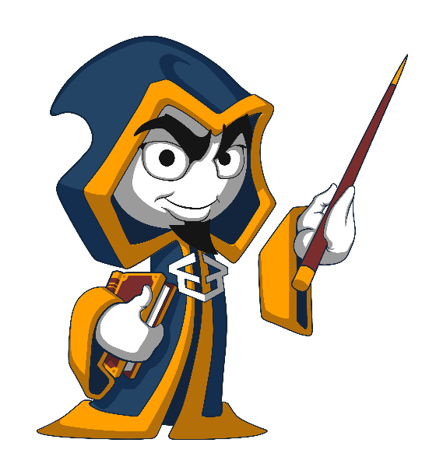
Summary
We are ready to move forward.

Slide 28
Questions?
Notes:
28

Slide 29

License
This course (slides, examples, demos, exercises, homework, documents, videos and other assets) is copyrighted content
Unauthorized copy, reproduction or use is illegal
© SoftUni – https://about.softuni.bg/
© Software University – https://softuni.bg
Notes:
29

Slide 30
Trainings @ Software University (SoftUni)
Software University – High-Quality Education, Profession and Job for Software Developers
softuni.bg, about.softuni.bg
Software University Foundation
softuni.foundation
Software University @ Facebook
facebook.com/SoftwareUniversity
Software University Forums
forum.softuni.bg
Notes:
30

